Slide 1
Implementation of a small address Map using A* Search Algorithm
Artificial intelligence and Experts Systems Lab
CSE 404
Project-1
Submitted By
Rifa Tasfia
19201045(A2)

Slide 2
Outline
01
Introduction
Designed map
03
02
Objective
Implementation
05
04
Search tree
06
Result analysis
07
Conclusion
02

Slide 3
Introduction
03
The assigned problem is implementation of a small address map from my home to UAP, using A* search algorithm and find out the optimal path. A* algorithm is a searching algorithm that searches for the shortest path between the initial state to the final state.
So, here in this project I will find the most optimal path from my home (Dhanmondi) to my university (UAP) using A* search algorithm.

Slide 4
Objective
04
In this project, I have to reach UAP from my home Dhanmondi by using the shortest path.
There are several path between Dhanmondi to UAP. But not all of those path are optimal. So I need to find out the optimal path. For finding, I’ve used the A*(A-star) search algorithm.
The objective of this project is to find an optimal path from my home (Dhanmondi) to my university (UAP).

Slide 5
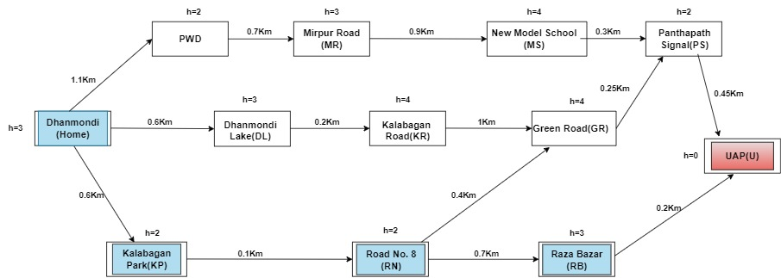
Designed Map
05

Slide 6
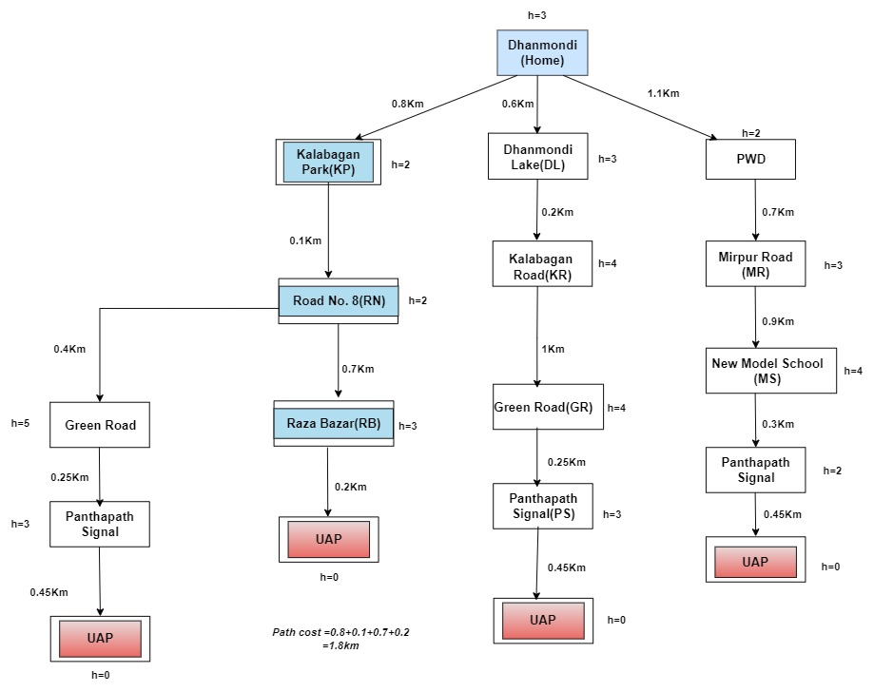
Search Tree
06

Slide 7
07
Implementation
Now I'll explain implementation part of this project.
I've used python for the programming language and implement it in PyCharm IDE.

Slide 8
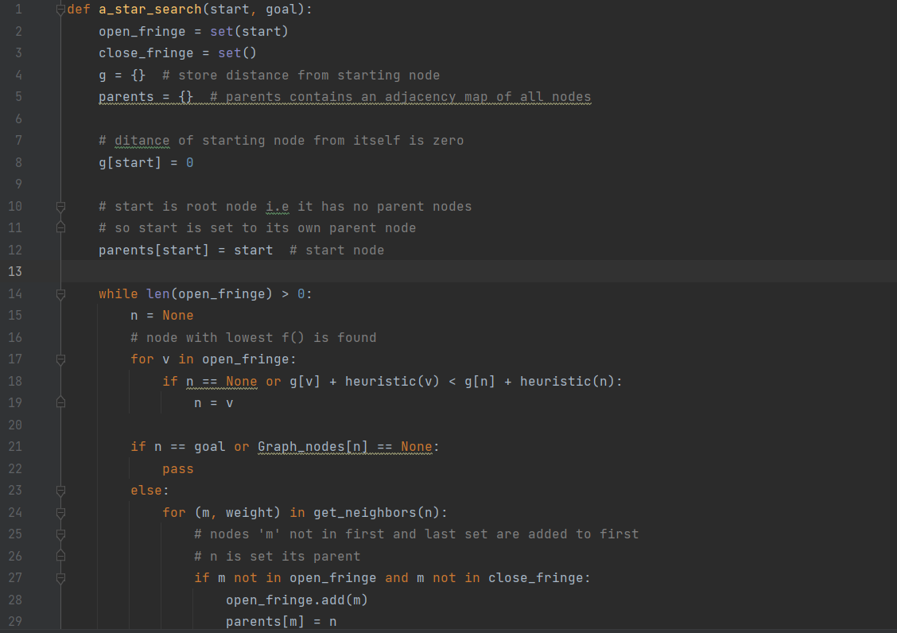
Implementation
08

Slide 9
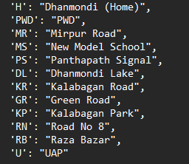
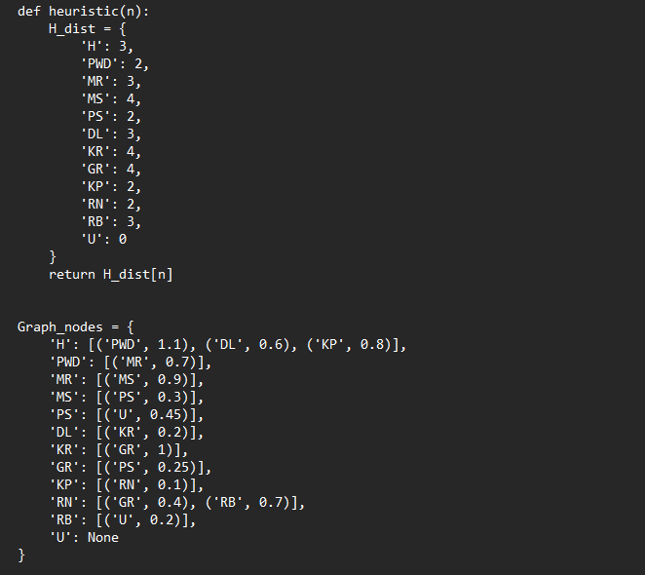
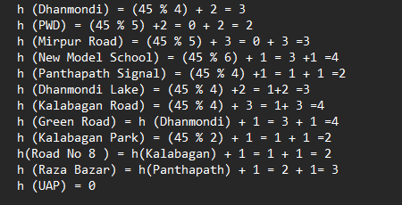
Input
09

Slide 10
Result Analysis
After Using A Star Search Algorithm on this designed map, on output we can find the shortest path
So, we can say that that is the most optimal and shortest path.
10

Slide 11
Conclusion
11
In this project, after successful implementation, A* search algorithm gives the most optimal path as output.
In conclusion, A* search algorithm is a powerful and beneficial algorithm with all the potential. So we can use this algorithm for approximate the shortest path in real-life situation, like - in maps, games, robotics etc.

Slide 12
Thank You

